Slide 1

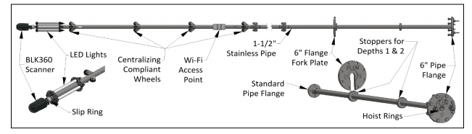
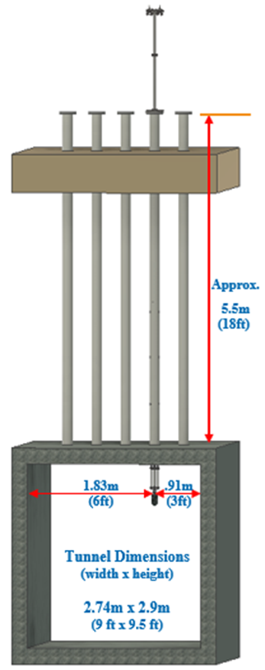
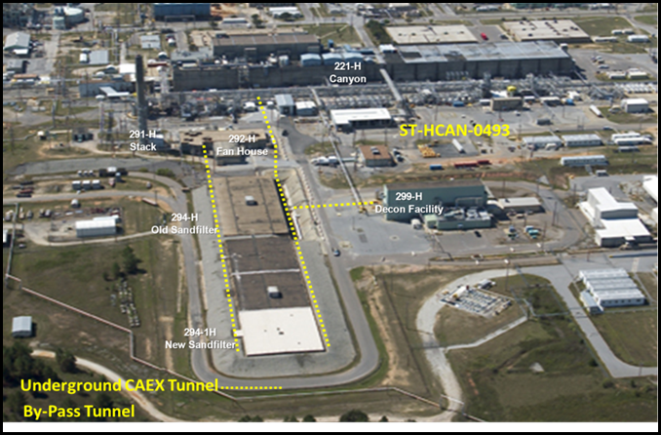
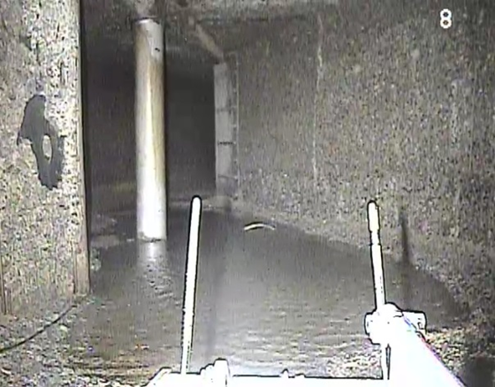
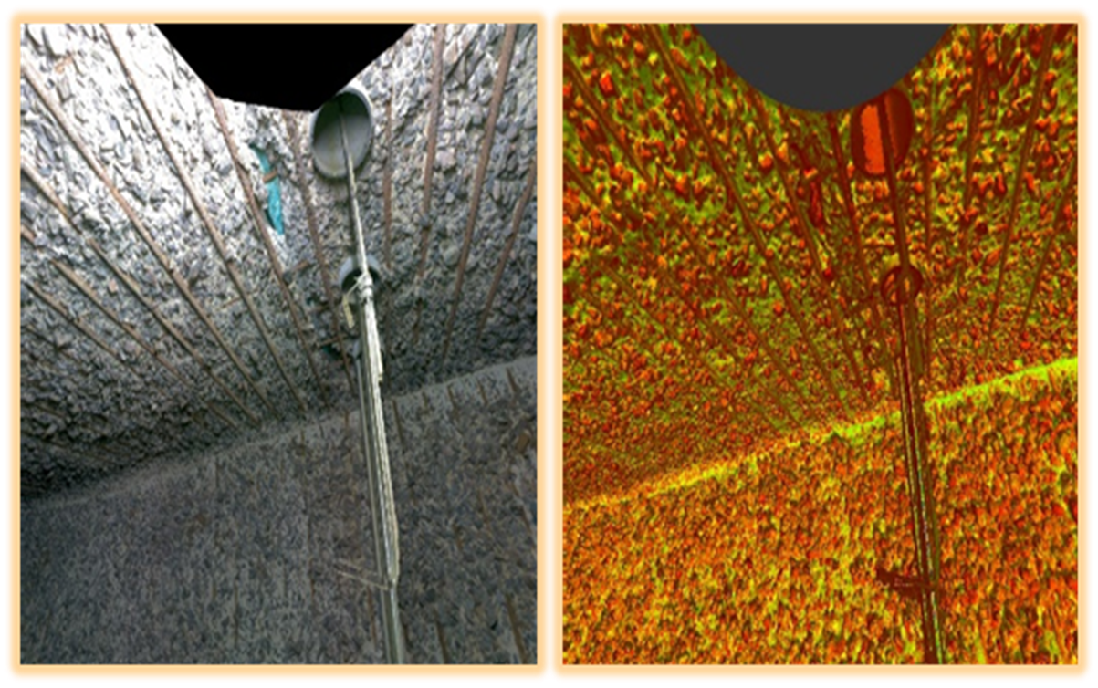
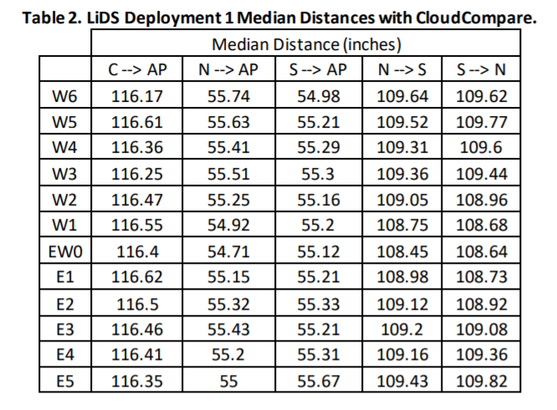
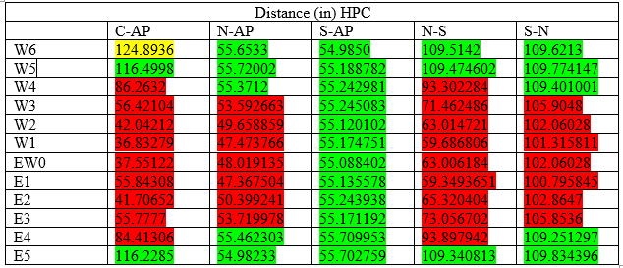
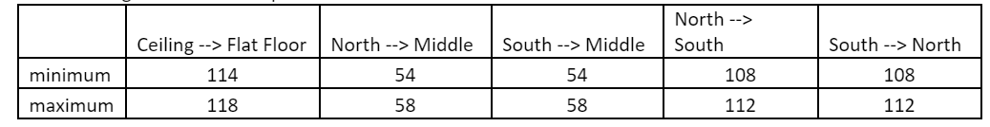
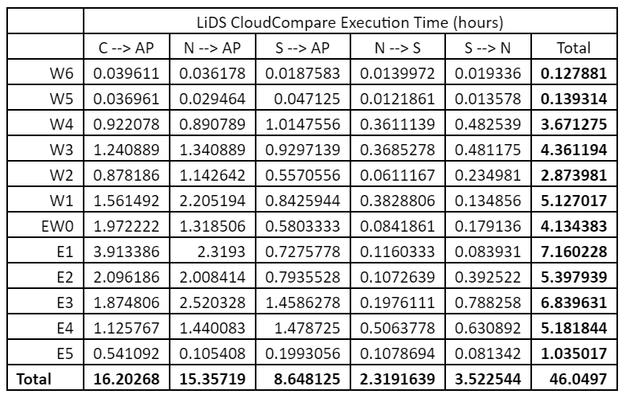
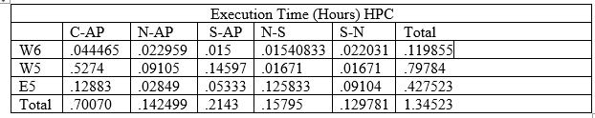
Examining the Performance of the Multi-Core Workstation and High Performance Computing
Student Author: Christopher Brunswick & Keith McBride
Mentor Names: Jean Plummer & Dr. Fralick
Abstract
Every two years, Savannah River Site(SRS) examines ethe inside of the H-Canyon Exhaust Tunnel(HCAEX) under the Structural Integrity Program.
HCAEX tunnel is presently examined using cameras, however test examinations using LiDAR are underway.
LiDAR examinations would provide quantitative data of the tunnel’s interior and may be able to determine the rate of erosion over multiple deployments.
Each deployment involves the use of a Leica BLK360 laser scanner. The LiDAR unit collects and analyzes point cloud data , imported onto autodesk iPad software, then processed on a 3D point cloud processing software known as CloudCompare.
The purpose of this collaborative research is to compare data processing speed of SRNL Multi-Core workstation and UofSC High-Performance Computer Hyperion.
Data Collection
Subcontractor assembled LiDAR on a stick (LiDS) for deployment
LiDS is deployed and scans nearly 200 foot section of tunnel interior
Multiple scans are collected from 3 different elevations
3 of the collected scans are merged
Merged scans are successfully transferred to recap pro mobile through an iPad and then to recap pro through a desktop above ground
CloudCompare
• CloudCompare 2.6.3.1 (Older version) was uploaded on HPC.
•CloudCompare is an open source 3-D point cloud processing software that allows comparison between two-point clouds.
•Compare entire sections of uneven surfaces within the tunnel’s interior. Point clouds of interest include scanned data of the ceiling, wall, and floor of the tunnel.
• Used 2D1/2 triangulation, radius of 0.25” algorithm for optimal cloud to cloud comparison accuracy
Filesharing over a Virtual Private Network (VPN)
Filesharing software filezilla client is used to queue (upload) data files on Hyperion user directory
FileZilla is a cross-platform file transfer protocol (FTP) application used to transfer computer files from a server to a client on a computer network.
Results
The following charts are an illustration of the results in tabular form. The chart to the right shows the distances that resulted from processing LiDAR data on Hyperion. The green are distances are the same as SRS. The red and yellow are different distances from SRS; it is safely to say that the yellow and red color represent corrupted data.
Figure 3: illustration of LiDAR assembly fabricated by vendor (JFT)
Figure 1: shows location of HCAEX tunnel
Figure 2:
Shows 2017
Inspection of
HCAEX tunnel
With use of
A mounted
crawler
Figure 5: LiDAR scan of the tunnel interior
Figure 4: Illustration of mock test of deployment showing south and north walls and ceiling and floor
Introduction
Savannah River Site wants to know if High- Performance Computing process data faster than what the site has been using, known as a Multi-core workstation.
Before comparing two processors, collecting data has been taking place.
Light Detection and Ranging system (LiDAR) undergoes deployment, which records distances from the starting point where LiDAR is scanning to the overall H-Canyon tunnel(HCAEX).
Once data has been scanned, it is transferred to recap pro mobile through an iPad, then it is transferred over to recap pro through a desktop. These scans are known as point clouds.
Post data processing of LiDAR data comprises of a single multicore machine: 18 cores with 44 MB
Longest execution time is 4 hours
CloudCompare and the SRS LiDAR data were uploaded on the HPC to determine the execution time and distances that were collected from LiDAR.
High-powered computation platform is created to illustrate the comparison between execution times of Savannah River Nuclear Laboratory (SRNL) multicore workstation and UofSC Hyperion cluster
Getting Access to UofSC High-Performance Computer (Hyperion)
UofSC High-Performance Computer (Hyperion) is being used to process data.
To get access with Hyperion cluster, there were steps to take, such as :
Getting in contact with University of South Carolina (UofSC).
Create accounts to use Hyperion
Implementing teamviewer software
Connecting with UofSc network through Virtual Private Network(VPN) ( AnyConnect Secure Mobility Client)
Link to Hyperion Cluster login screen (Graphical User Interface)
Launch Hyperion Desktop!
This chart represents the correct range of distances
Conclusions
Since most of the data within the point cloud segments were corrupted, we only looked at the segments that were overall good data. The good data we looked at were west 6, west 5 and east 5. Comparing the execution time with SRS’S Multi-core workstation and UofSC HPC, we have concluded that HPC have processed west 6, west 5 and east 5 slower than the multi-core workstation.
Future research on this project would detail the reasons for data corruptions. Also, understanding the reason for slower processing speed on an HPC platform in comparison to a multicore workstation.

